Slide 1
Server-Side Reactive Programming with RxJava
Prepared for Virtusa
Notes:
Who is running microservices in production?
Who is on that path or wants to be?
Who thinks this microservices thing is a load of rubbish and loves their monolith?

Slide 2
Lesson Goals
Understand server-side reactive programming

Slide 3
Hands-On
Apply reactive programming to our Shipping Service
Refactor Customer Purchase History to use RxJava instead of Futures

Slide 4
Why?
Synchronous Blocking APIs limit scalability and performance of our microservices
Asynchronous Non-Blocking APIs free up threads to handle additional requests
In many cases, stream processing against observables results in cleaner code and less code

Slide 5
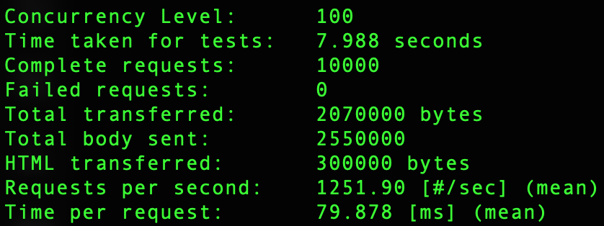
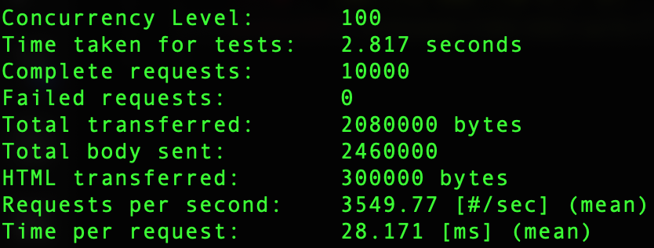
Blocking
Non-Blocking
https://morioh.com/p/f0ffa18cc9c4

Slide 6
Returning Single
@GetMapping
public Single<String> single() {
...
}
@GetMapping
public ResponseEntity<Single<String>> singleWithResponse() {
...
}
@GetMapping
public Single<ResponseEntity<String>> singleOuterWithResponse() {
...
}
@GetMapping
public Single<Object> error() {
return Single.error(new RuntimeException("Unexpected"));
}

Slide 7
Returning Single
@GetMapping
public Customer Get(int id) {
...
}
@GetMapping
public ResponseEntity<Customer> get(int id) {
...
}
@GetMapping
public Single<Customer> get(in id) {
...
}
@GetMapping
public ResponseEntity<Single<Customer>> get(int id) {
...
}

Slide 8
Returning Observable
@GetMapping
public ResponseEntity<Observable<String>> responseWithObservable() {
...
}
@GetMapping
public Observable<String> observable() {
...
}

Slide 9
Returning Observable
@GetMapping
public List<Customer> get(int id) {
...
}
@GetMapping
public ResponseEntity<List<Customer>> get(int id) {
...
}
@GetMapping
public Observable<Customer> get(in id) {
...
}
@GetMapping
public ResponseEntity<Observable<Customer>> get(int id) {
...
}

Slide 10
Thank You!

